Slide 1



SMART LEDGER
- AI powered Personal Finance Tracker
Tech Stack: DotNet ,Angular ,AI
Done by Anudeep

Slide 2
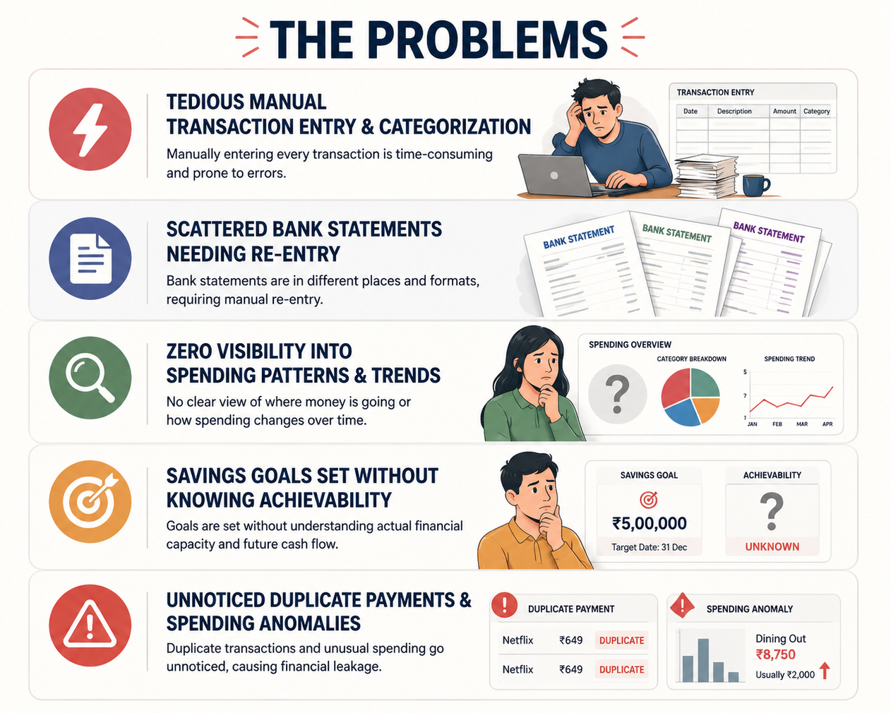
Problem Statement

Slide 3
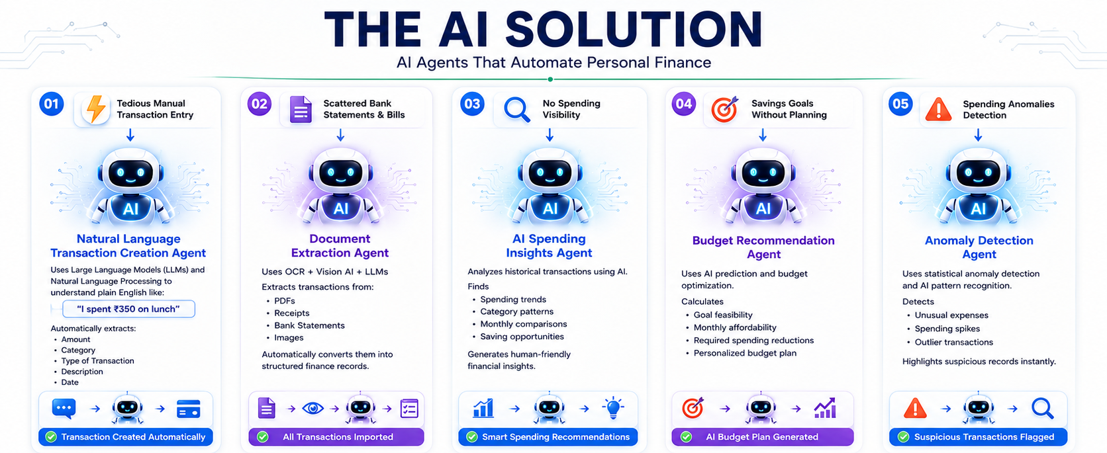
AI Solution-Smart Ledger

Slide 4
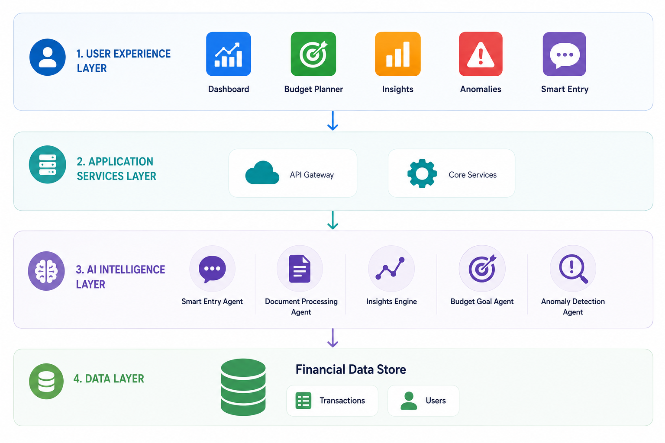
Architecture Diagram

Slide 5
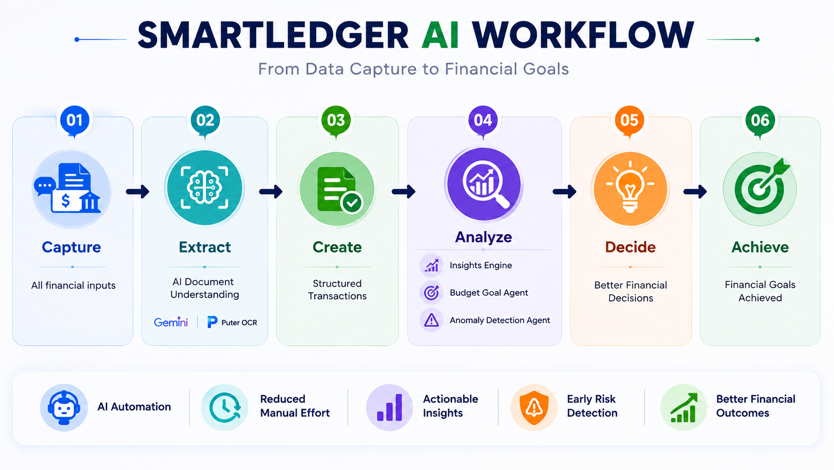
Application WorkFlow

Slide 6
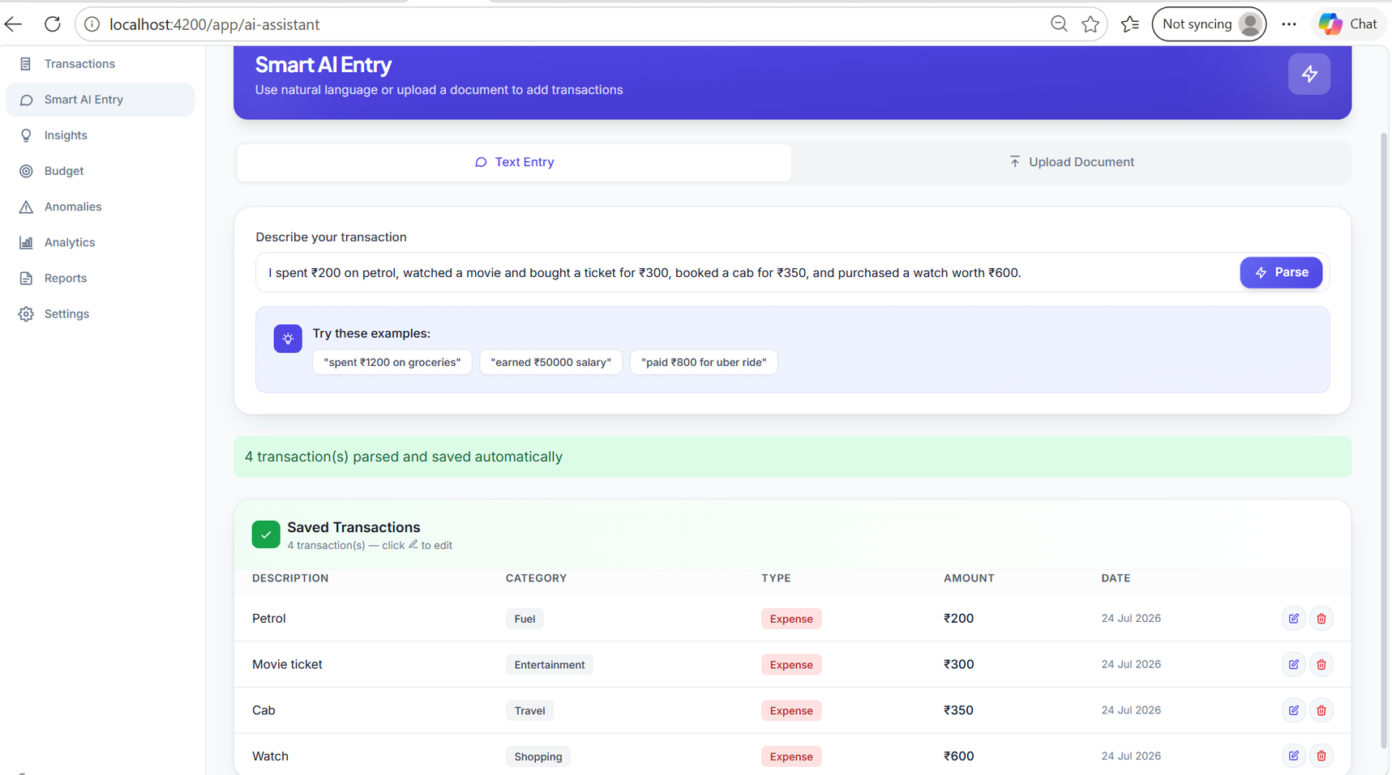
Agents Implementation:
Agent 1:Natural Language Transaction creation Agent

Slide 7
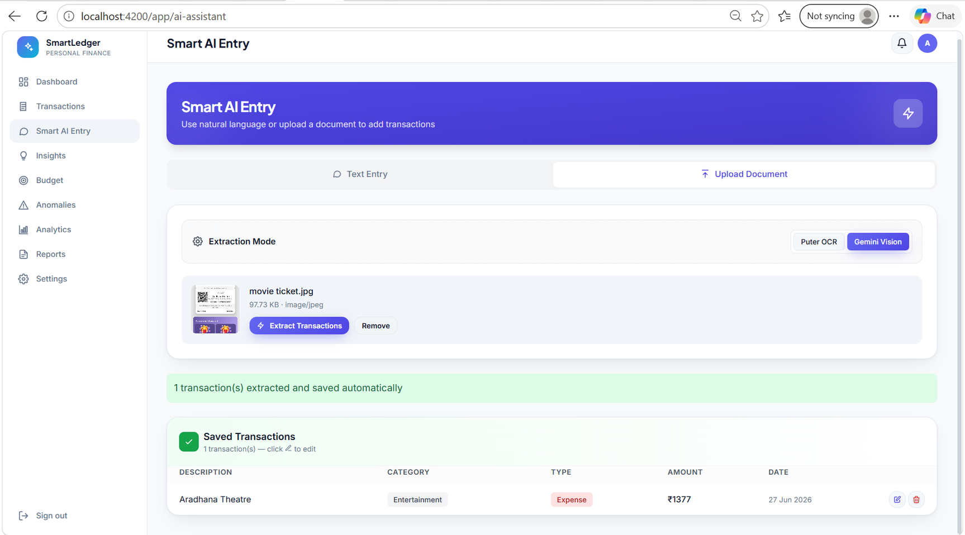
Agent 2:Document Transactions Extraction Agent

Slide 8
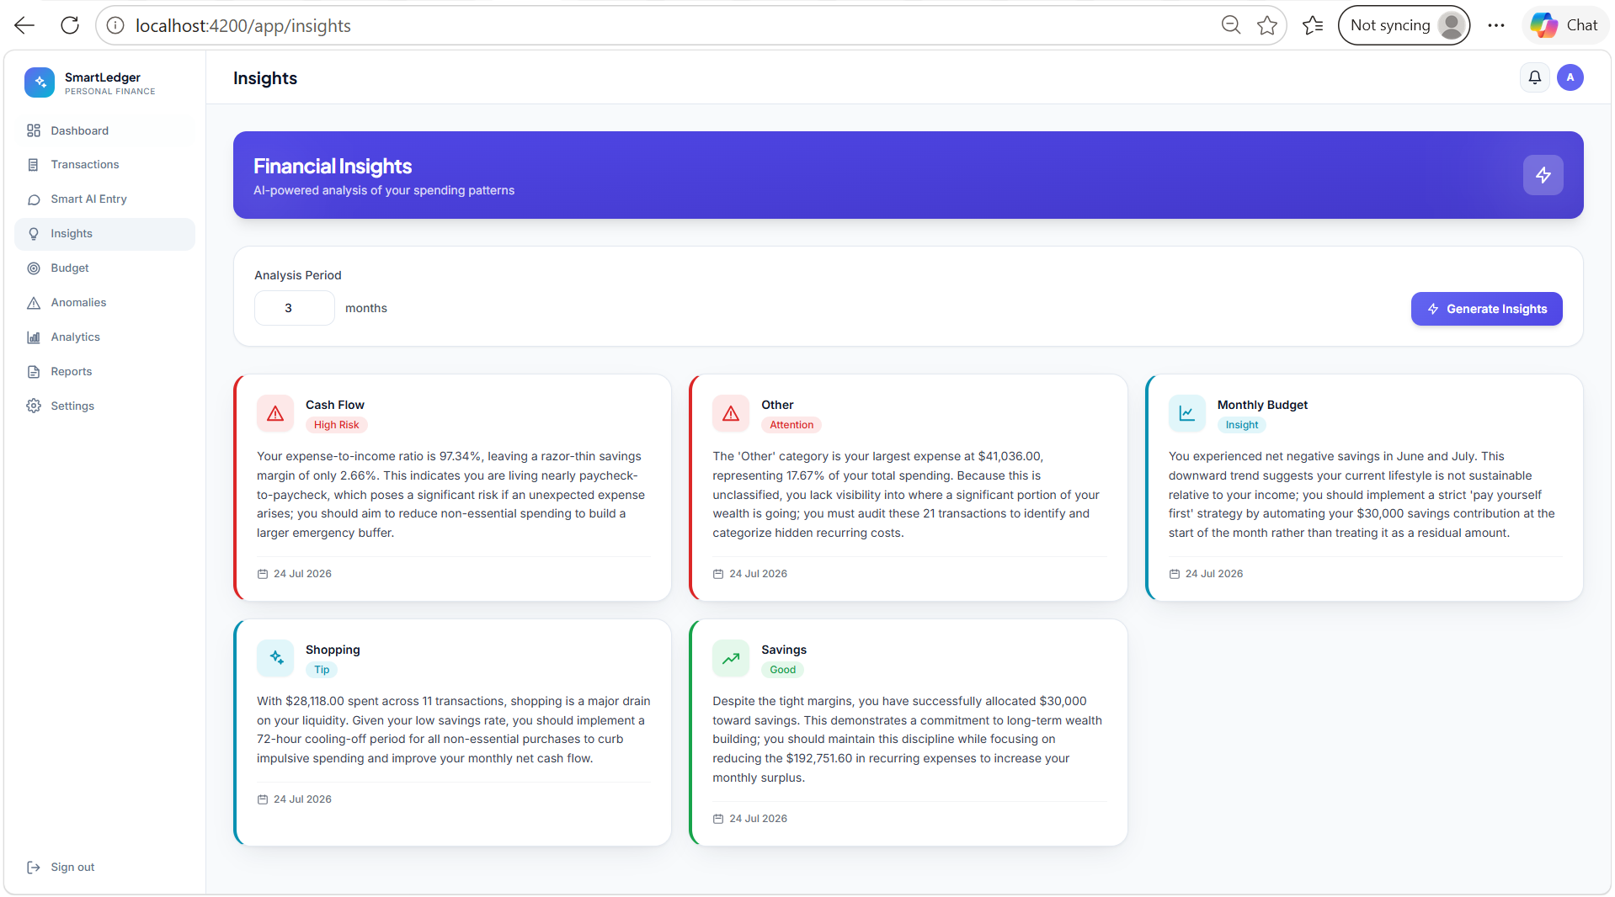
Agent 3: AI Spending Insights Agent

Slide 9
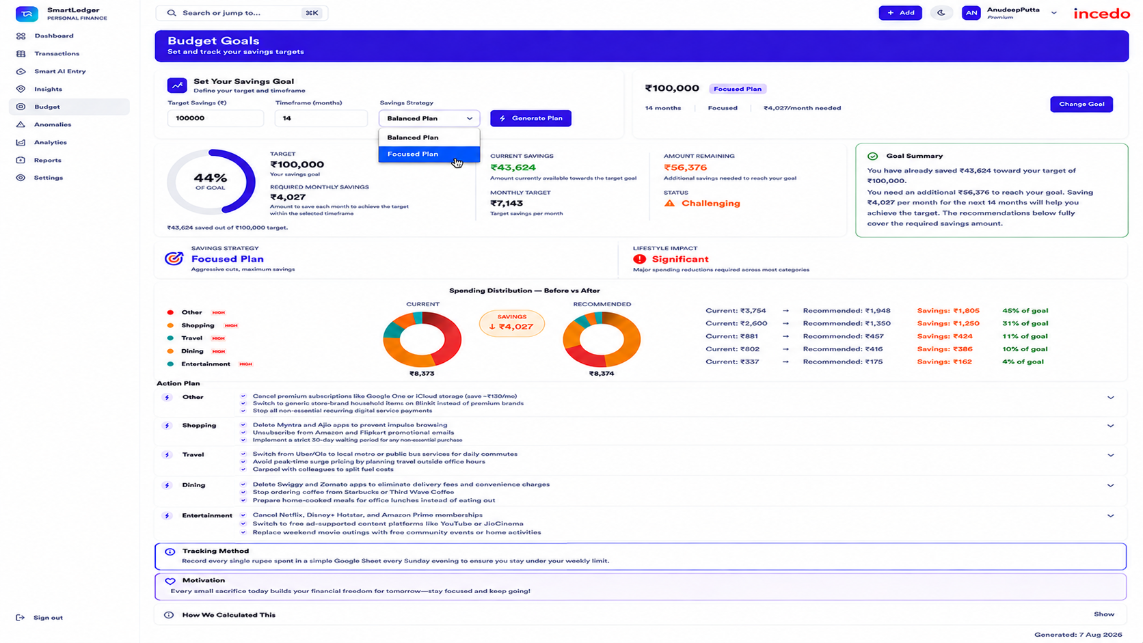
Agent 4: Budget Recomendation Agent

Slide 10
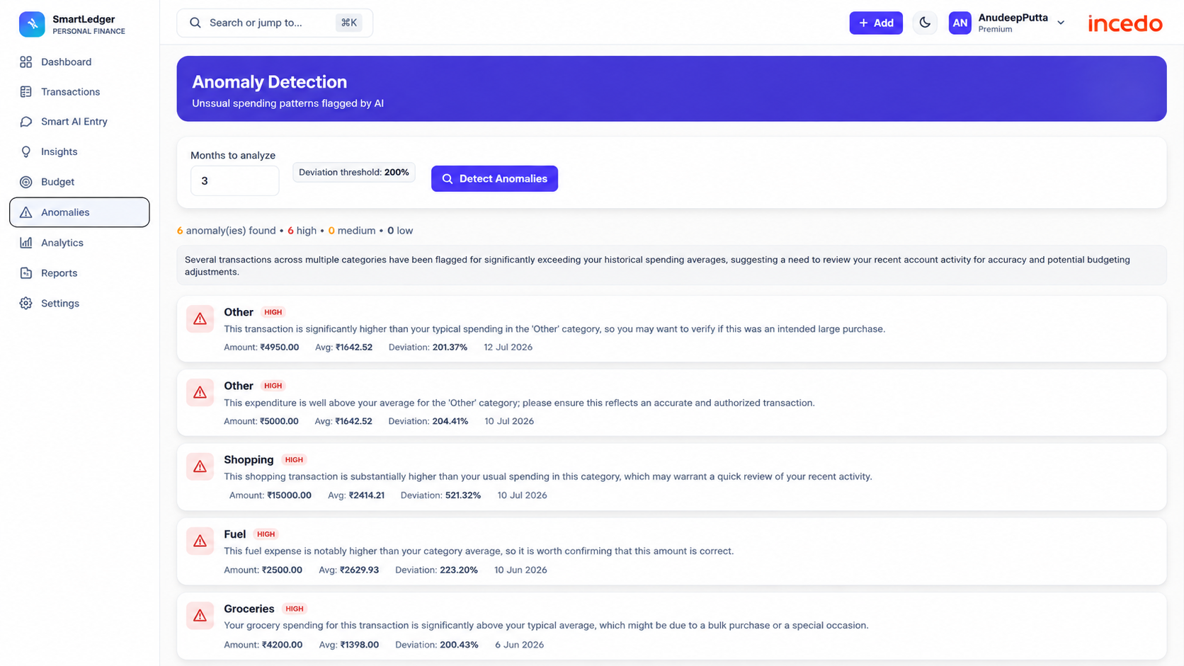
Agent 5: Anomaly Detection Agent

Slide 11
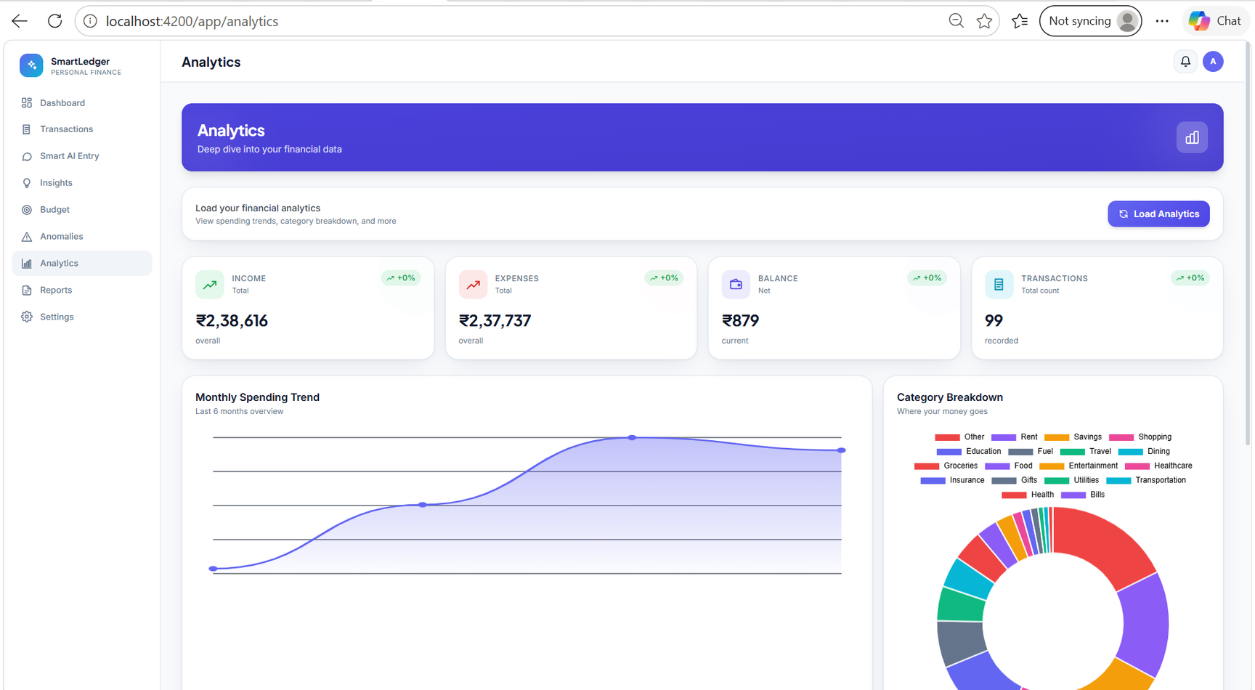
Analytics:

Slide 12
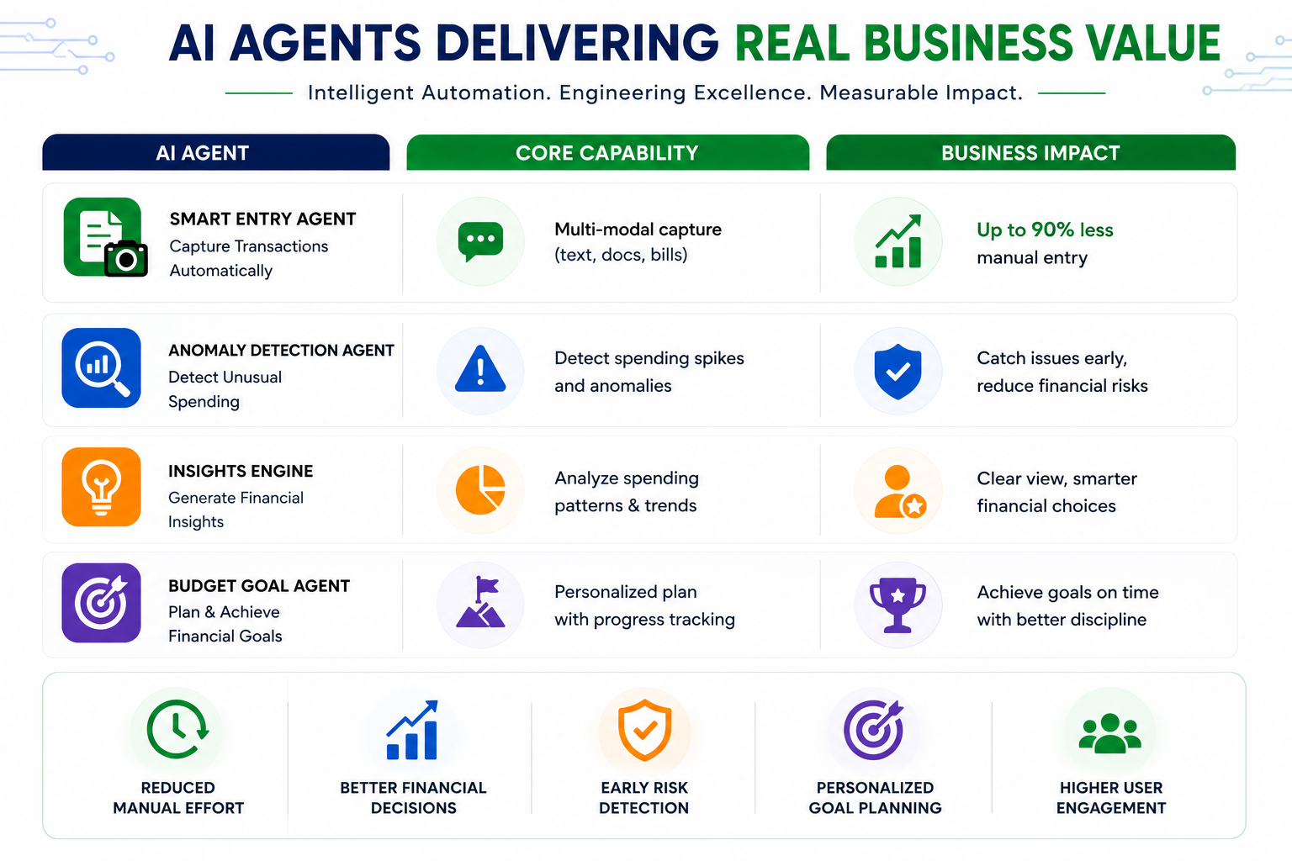
Bussiness Impacts:

Slide 13
THANK YOU

